Slide 1



Slide 2

ChatMate Helps you Connect and Share with the People in your Life.

Slide 3

Our Project
ChatMate is Chatting Website like WhatsApp, Messenger etc. We have used the Latest web Technologies to Develop this Website including Node.js, Express, SocketIO.
Our main Goal is to make it easy to communicate with people anywhere in the world by sending and receiving messages in real time.
With ChatMate, users are able to experience the same engaging and lively interactions as they would in person through customizable messaging features.

Slide 4
Contents
Team Members
Technologies
Working
Our Project
Introduction to our Team Members
Technologies and Languages we have Used.
Working of our Project.
Implementation / Demonstration of our Project.

Slide 5
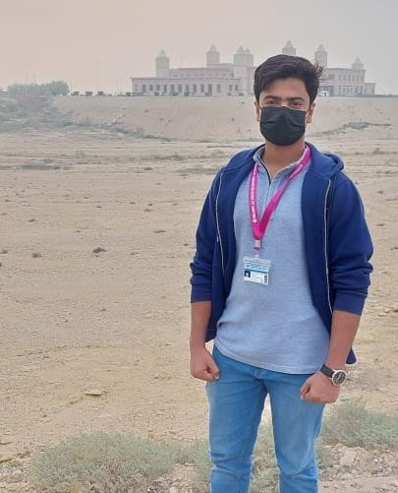

Our Team
Jawad Jahangir Soomro
Zohaib Ahmed Khoso

Slide 6
Zohaib Ahmed Khoso
- Front End and Back End Developer
- Good Skills in Java, HTML, CSS, React, Node.js.
- Passionate Developer
-Exploring Backend Development Now adays.

Slide 7
Jawad Jahangir Soomro
- Front End Designer
- Graphic Designer
- Good Skills in Java, HTML, CSS, Adobe Illustrator.
-Exploring Machine Learning Now adays.

Slide 8






Technologies
Front End
Back End
Library/API

Slide 9
Working
Our project is working on web-socket basis in which server and clients share data with each other without making any kind of HTTP request thus we achieve real time communication between users.
Socket IO works on the basis of web-sockets in which some data is transmitted to the server and then the server broadcasts that data to specific chat rooms that we have defined.

Slide 10
Features
- Real Time Communication.
- Group Chat.
- End to End Communication by joining same Room.
Voice Call and Video Call (in Future)

